Slide 1

Unpaved Roads in the Buffalo River Watershed Report

Slide 2
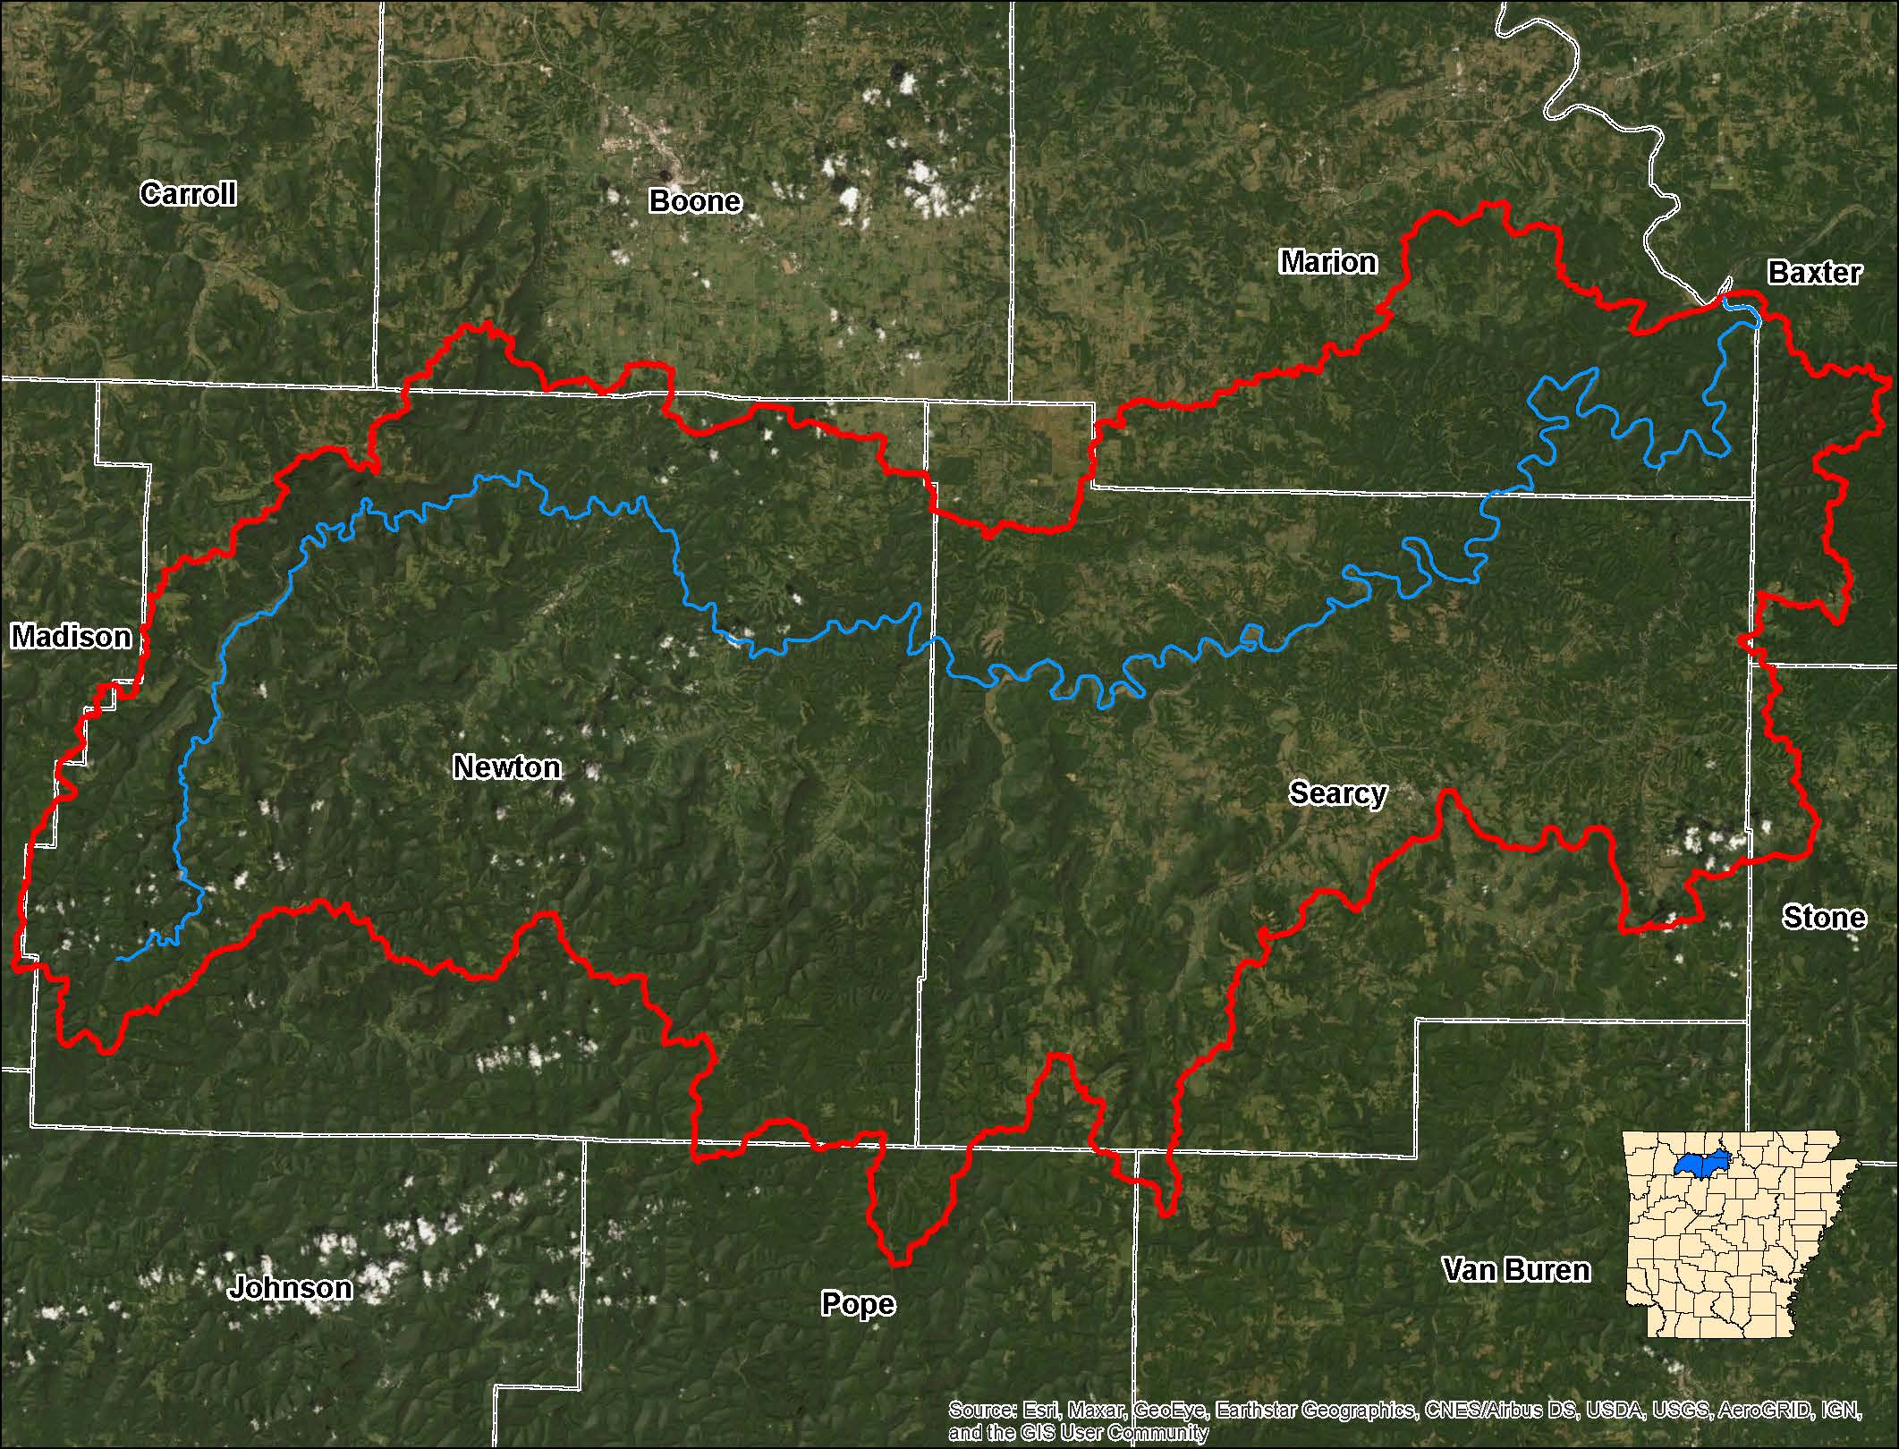
Geography of the Buffalo River Watershed
The Buffalo River watershed begins along the western border of Newton County. The river flows easterly to meet the White River. The watershed drains roughly 1,330 square miles of the Boston Mountains and Ozark Highlands. It covers parts of eight counties. The terrain is rugged and steep. The majority of the watershed lies in Newton and Searcy counties, with the smallest portion lying in Van Buren County.

Slide 3
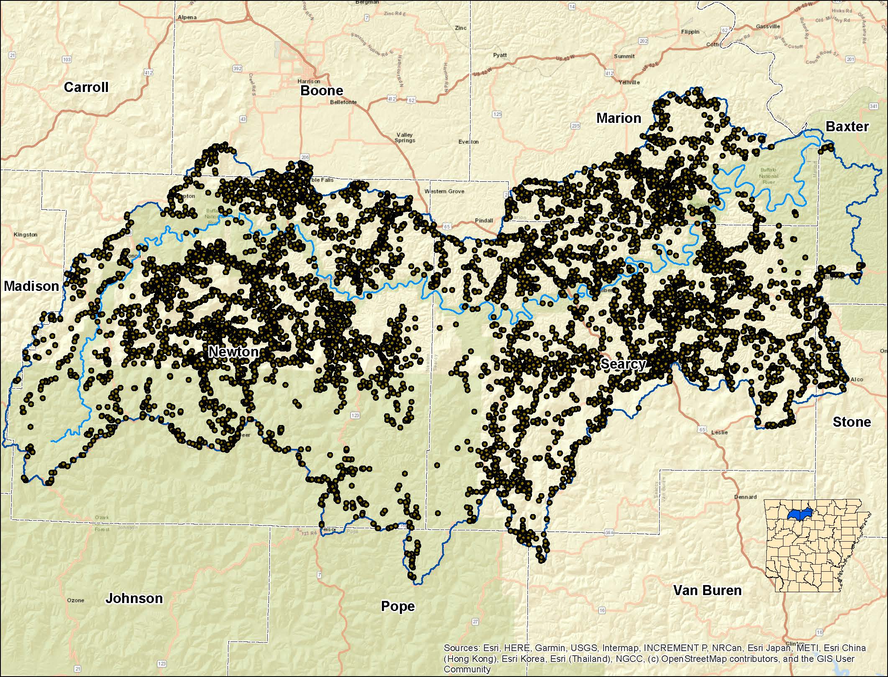
Distribution of Population in the Watershed
The watershed’s estimated population is around 18,000. The majority of population is situated in Newton and Searcy counties.
* Estimate derived by factoring the number of 9-1-1 addresses by 1.8

Slide 4
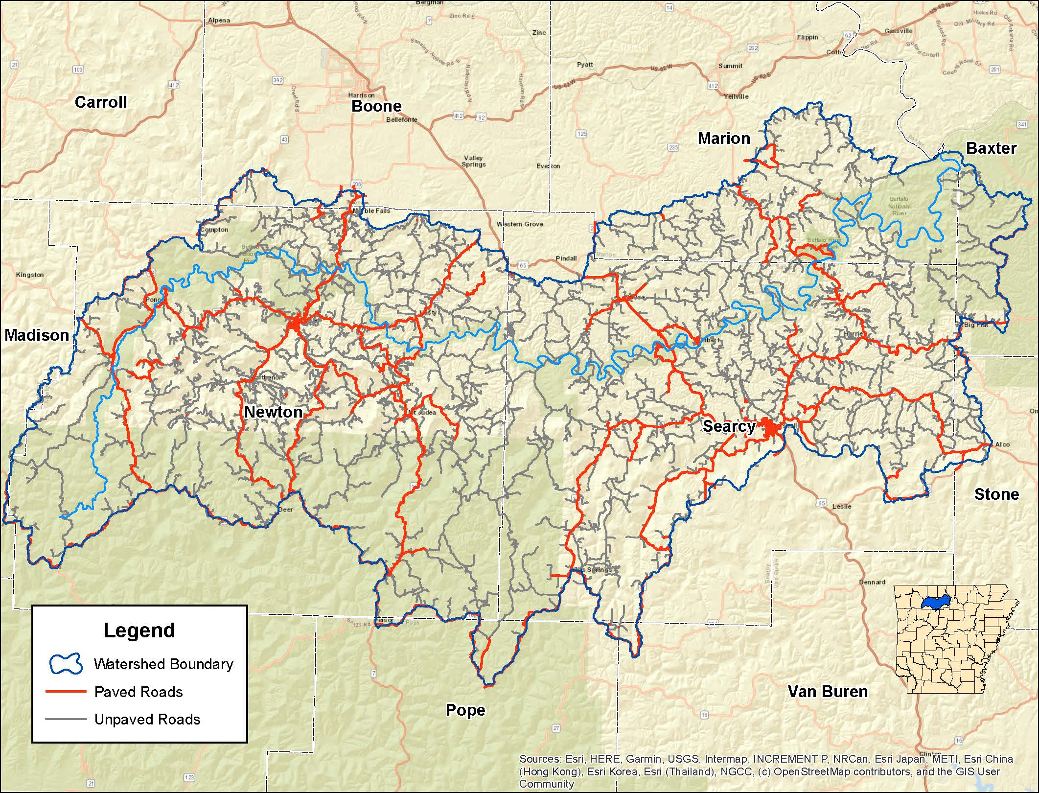
2,518 Miles of Roads in the Buffalo River Watershed
Of the 2,518 miles of road in the watershed, the majority are unpaved. The pie chart below illustrates that 1,245 miles or 62% of unpaved roads are under county jurisdiction. Of that 1,245 nearly 630 miles or 31% are privately owned. These may be driveways to farms or residences.

Slide 5
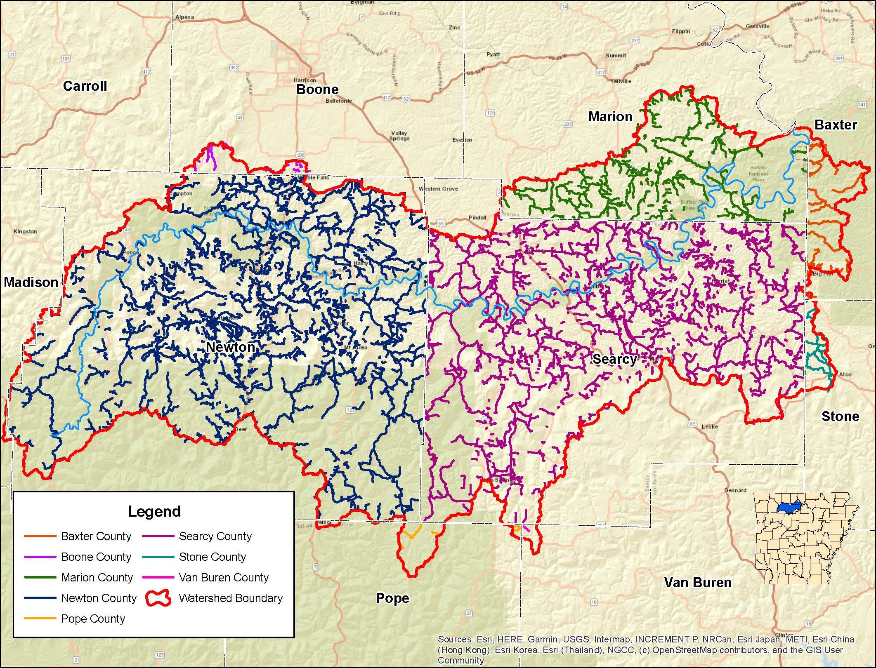
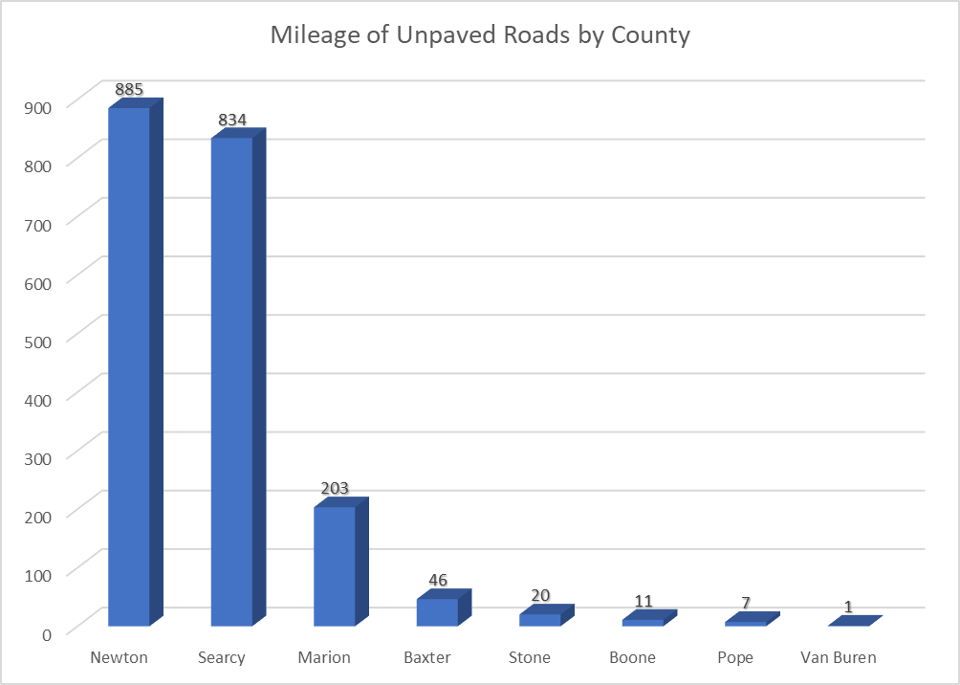
80% of Roads in the Watershed Are Unpaved
2,007 of the 2,518 miles of roads are unpaved. The majority these can be found in Newton (885 miles) and Searcy County (834 miles). Marion, Baxter, and Stone contain 203, 46, and 20 miles respectively; with only 11 in Boone, 7 in Pope and 1 in Van Buren.

Slide 6
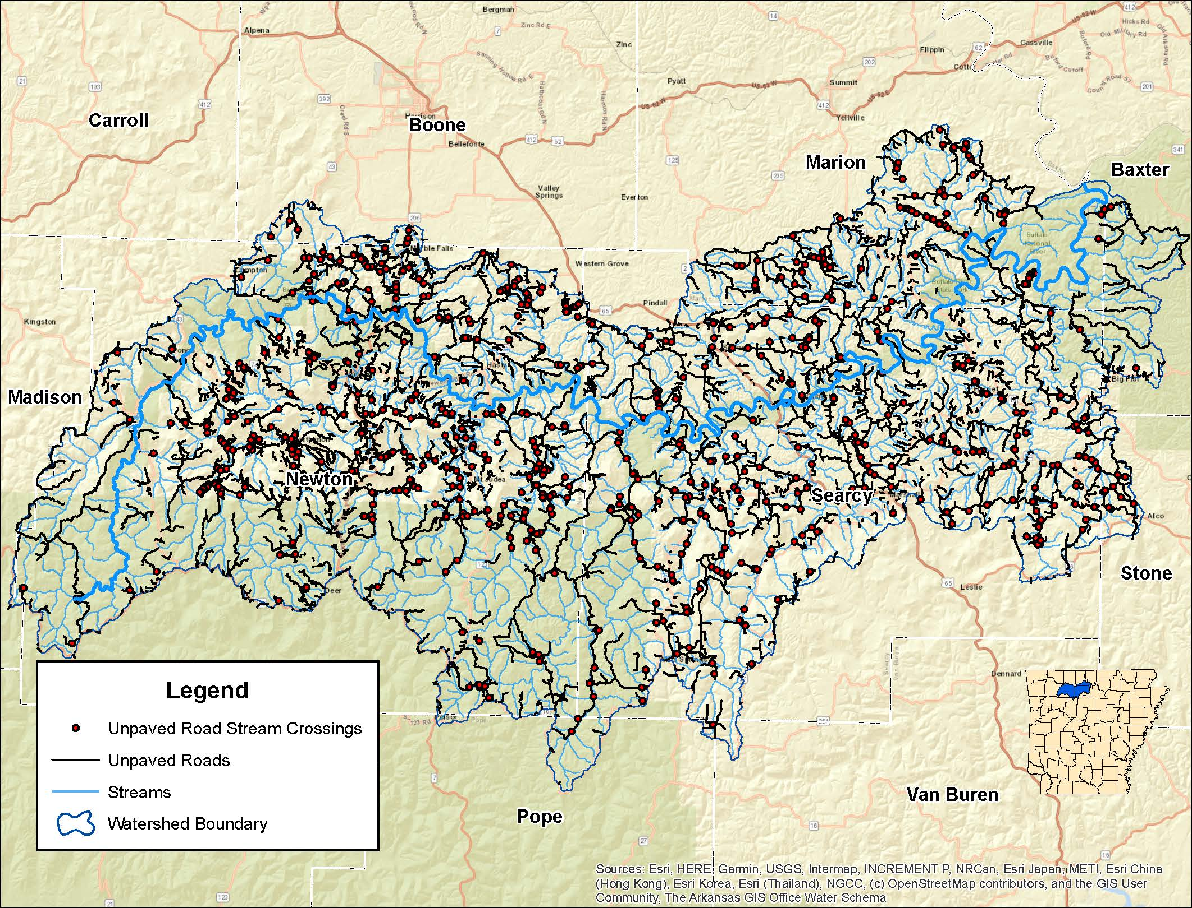
Unpaved Road Stream Crossings in the Watershed
The Buffalo River Watershed contains 668 points where an unpaved road crosses a stream. Of those 668 Newton County has 322, Searcy 258, and Marion 67 stream crossings. Stone County follows with 9, Boone 6, Pope 4 and Baxter 2

Slide 7
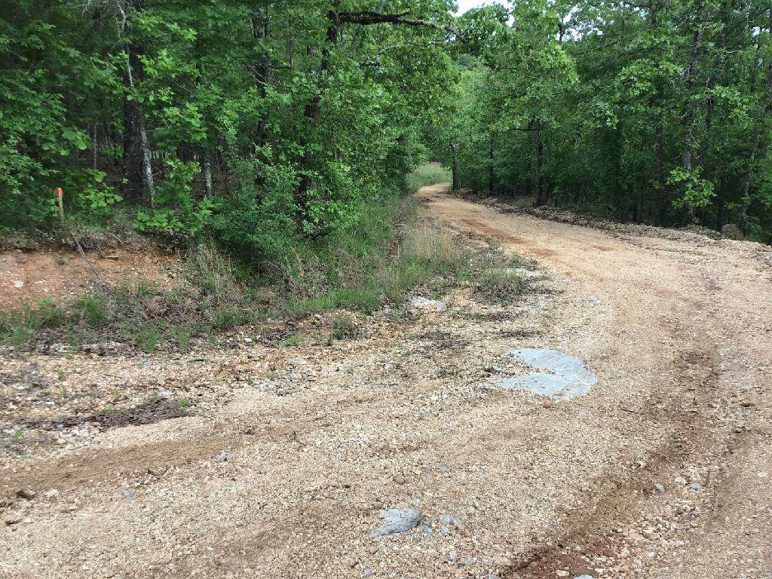
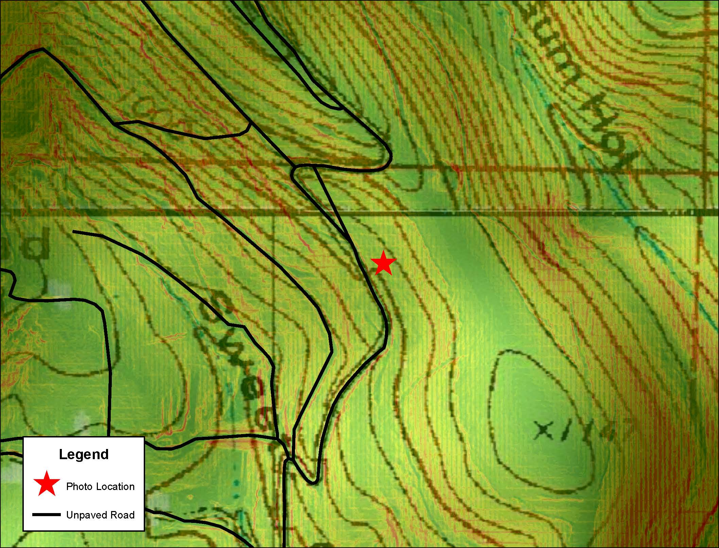
Topography of an Unpaved Road in Northwest Searcy County

